Slide 1

Class Exercises
Ver 1.0

Slide 2
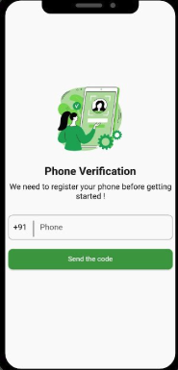
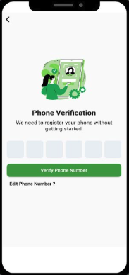
Class Exercise 1
Create two new screens to login with phone number.
Example:

Slide 3
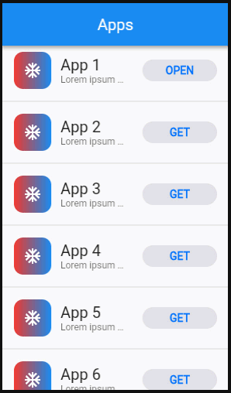
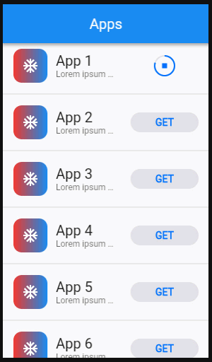
Class Exercise 2
Create a new screen to download items.
This is only dummy screen. Currently no actual download should occur.
Example: https://docs.flutter.dev/assets/images/docs/cookbook/effects/DownloadButton.webp

Slide 4
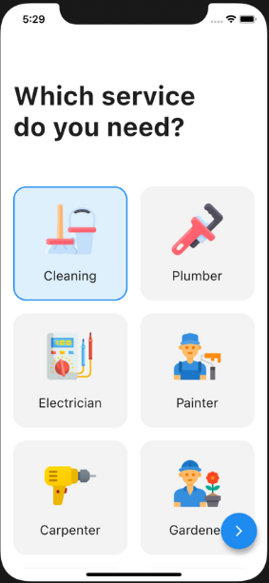
Class Exercise 3
Create a new screen, name it Dashboard.
On right button click, another menu appears.
Add back button [from the second screen].

Slide 5
Class Exercise 4
Duplicate screen from previous task.
At the bottom, add BottomNavigationBar Add 3 tabs (Home, Settings, Profile), each with different content.

Slide 6
Class Exercise 5
Create a new profile screen.
Include your photo, contact details & social account links.
You may add other information as well.

Slide 7
Class Exercise 6
Create new Setting screen. Add three dummy toggle buttons.
Navigation should work from Dashboard screen. Home\Settings\Profile screens.

Slide 8
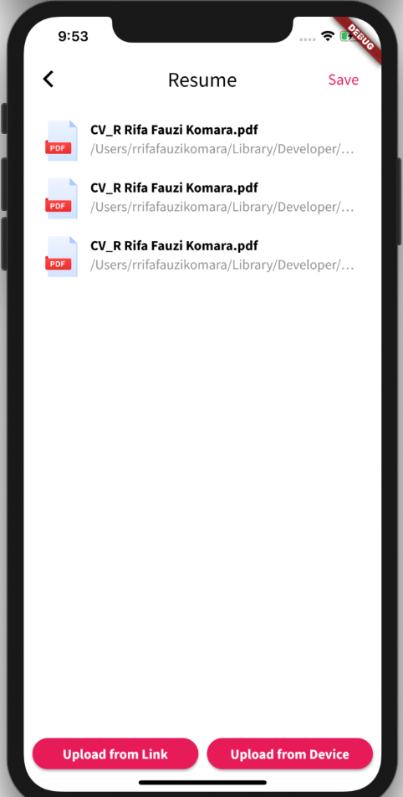
Class Exercise 6
Add screen with items as in the screenshot

